Slide 1


Slide 2


Agenda
1、Pain points and our solutions
2、Our users
3、Revenue and distribution
4、Our advantages
5、Stafi economics
6、Live demo
7、Future works

Slide 3
Pain points and our solutions
Current pain points
Official staking is not flexible and not liquid, and could not generate extra yields for delegators
Collators should have a large reserve to keep themselves in the active set → low capital efficiency
Technically capable, non-whale community contributors are impossible to be a collator
Our solution
A friendly, flexible, and community-centric staking DAO with boosted APY
An elastic delegation pool enabling bribes from collators
Dynamic staking and delegation controlled by DAO roles

Slide 4
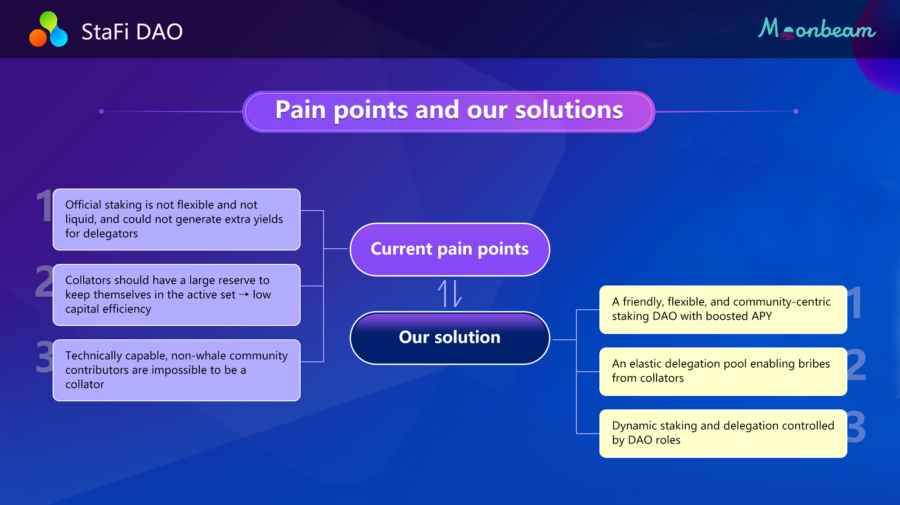

Slide 5
Our users
Long-term blockchain investors, builders, and community members
Technically-capable non-whale community collators
Potential collators without technical backgrounds
Retail delegators not meeting minimum staking bar
Investors perusing stable, optimized yield and good liquidity

Slide 6
User profiles
Profiles of our users
Delegators：Stake tokens, get delegation rewards and airdrops
Collators：bribe to rent delegations from DAO, get collation rewards
Node operators：provide Ops services to DAO, get service fee

Slide 7
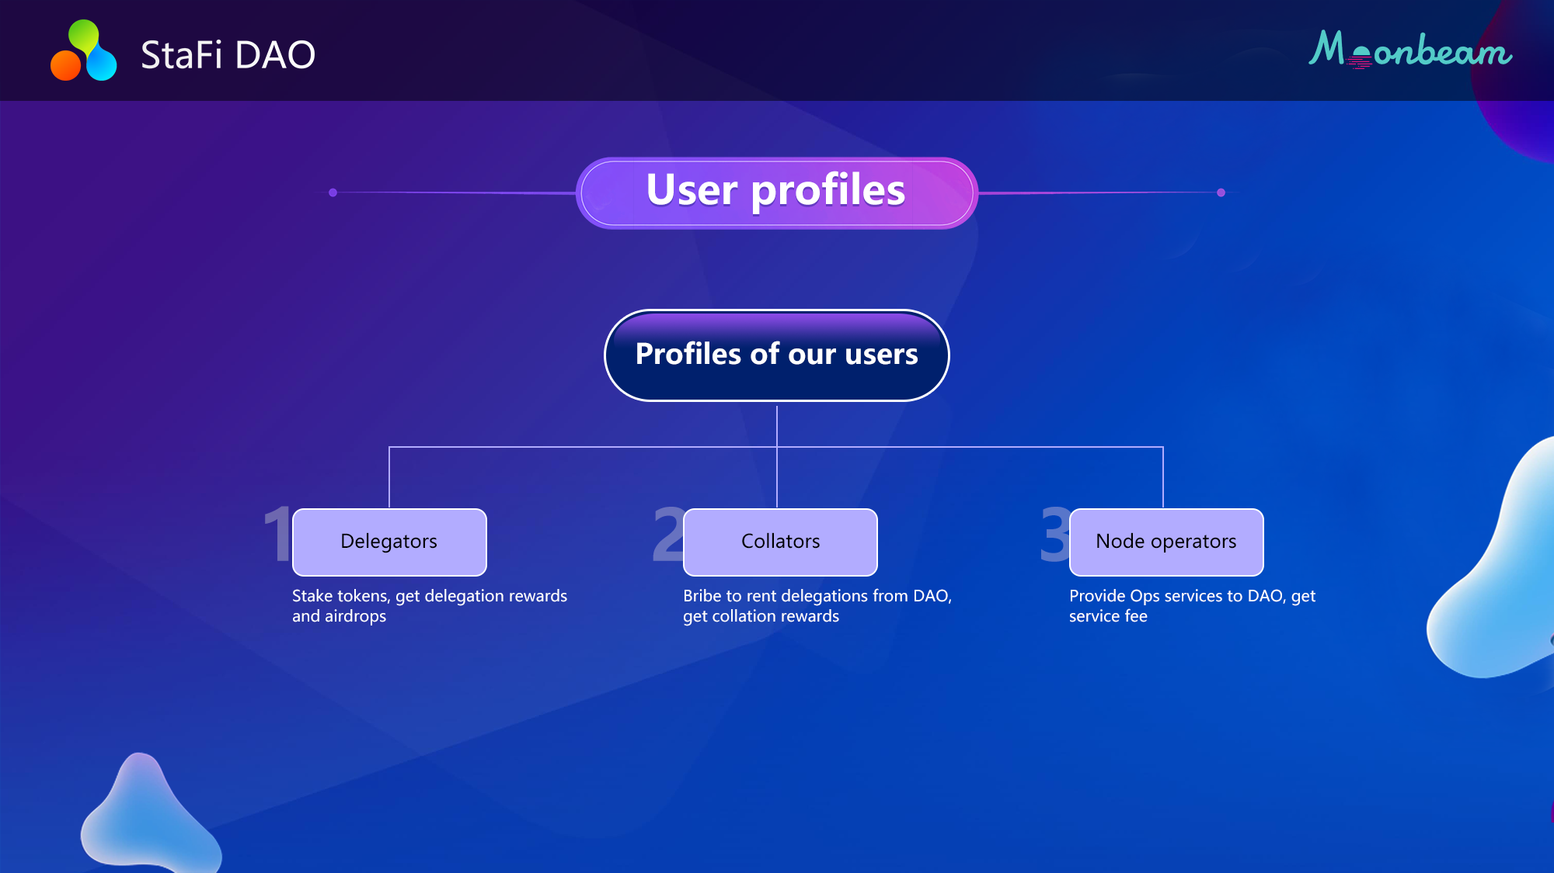

Slide 8
Revenue and distribution
Source of revenue
Bribes and delegation rewards
DAO rental token retToken could then accrue values
Growth of retToken value along with the DAO
Revenue distribution
Delegators: pro-rata delegation rewards and airdrops (swappable in DEX)
Collators: collation rewards (not included in DAO delegation rental revenues)
Node operators: service fees for technical supports

Slide 9
Our advantages
User-friendly and flexible delegation rental service
Boosted stable APY for delegators
Strong consensus for community-first governance and bonds among cokmunity members
Long-term stable delegations, higher capital efficiency and flexible deployment for collators renting delegations

Slide 10
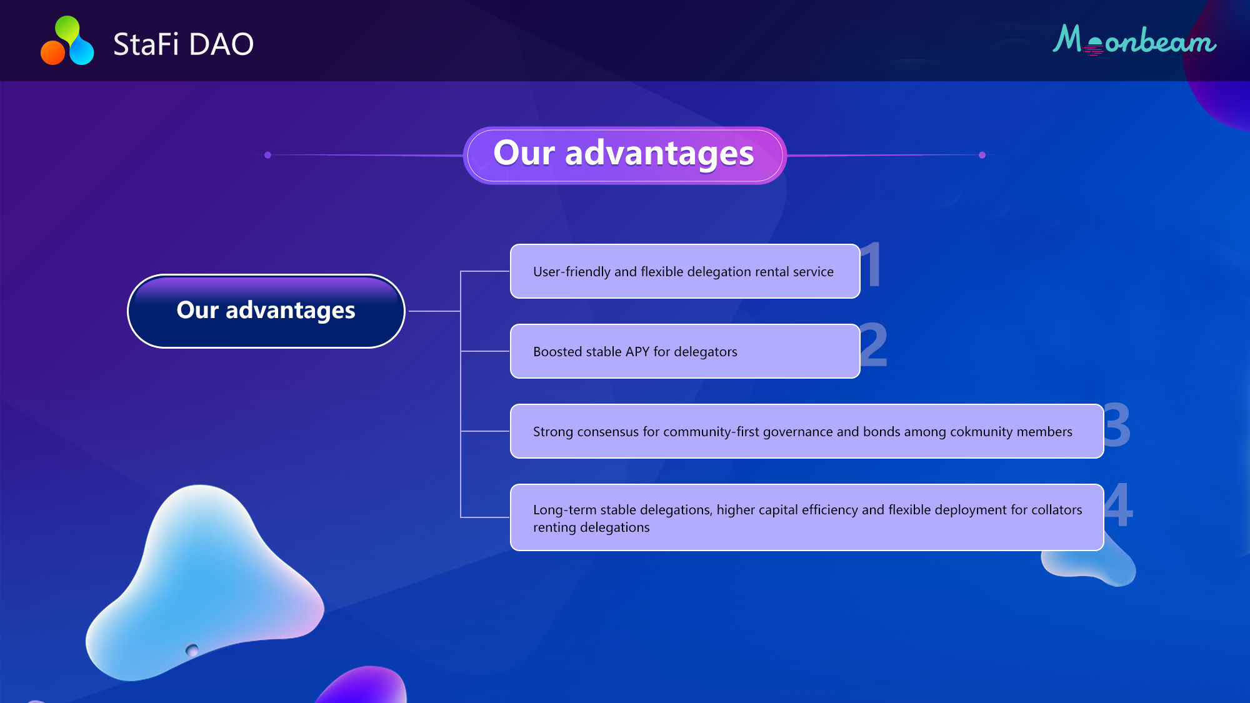

Slide 11
Tokenomics overview
stkToken: minted 1:1 when staking tokens, 1:1 redeemable back to tokens, burn when redeem
retToken: stkToken holders are periodically airdropped retToken pro-rata; collators 1:1 burn and stake retToken, and get delegated from the pool for one or more periods. Staking rewards in the rental period will be directed to the pool and stkTokens will be minted for eligible stkToken holders.
Swaps：stkToken-Token, retToken-USDT, etc.

Slide 12
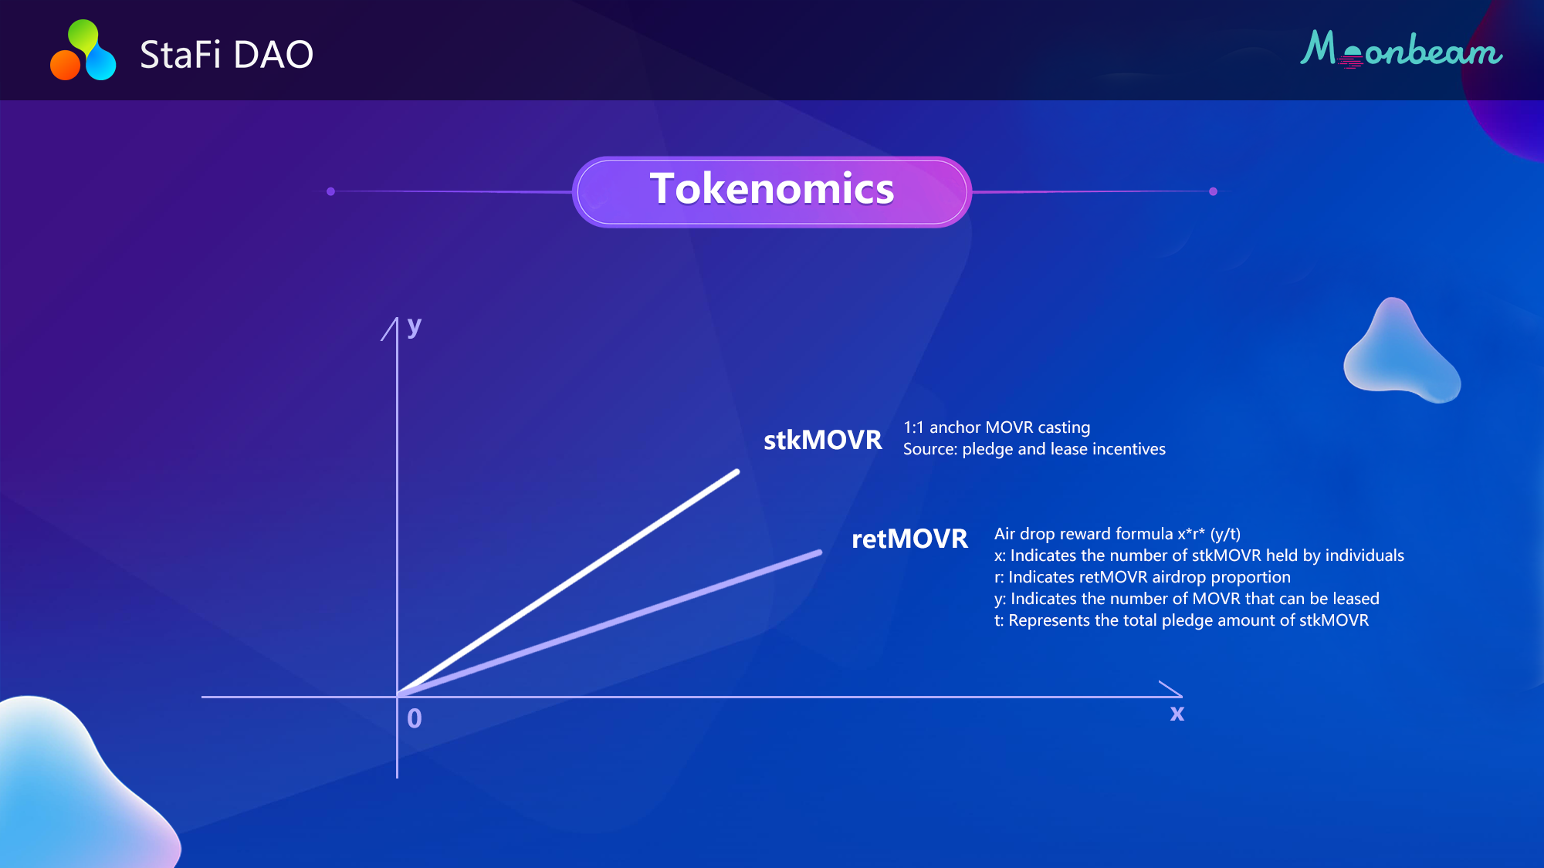

Slide 13
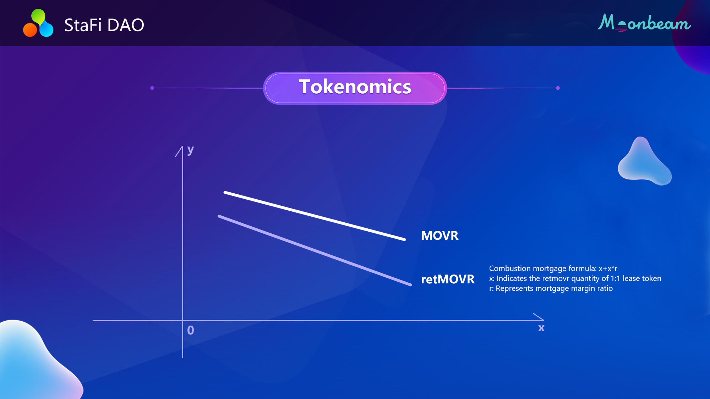

Slide 14
Live Demonstrations
Delegator
Governance: proposal and voting
Stake MOVR to get stkMOVR, hold stkMOVR to get staking rewards and airdropped retMOVR
Swap stkMOVR for MOVR, swap retMOVR for USDT
DAO governance
Staking pool, airdrop pool and reward pool parameters
Collators renting delegations
Stake and burn retMOVR for MOVR delegations
Node staking rewards sent to the reward pool
Expired MOVR rentals returned to staking pool

Slide 15
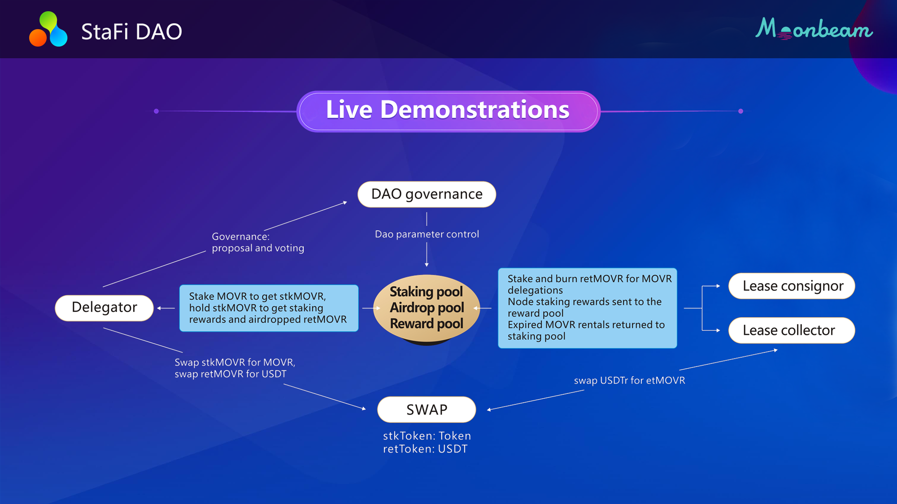

Slide 16
Future works
Multi-chain
DeFi lending：utilize current pools in DeFi
Investment DAO

Slide 17
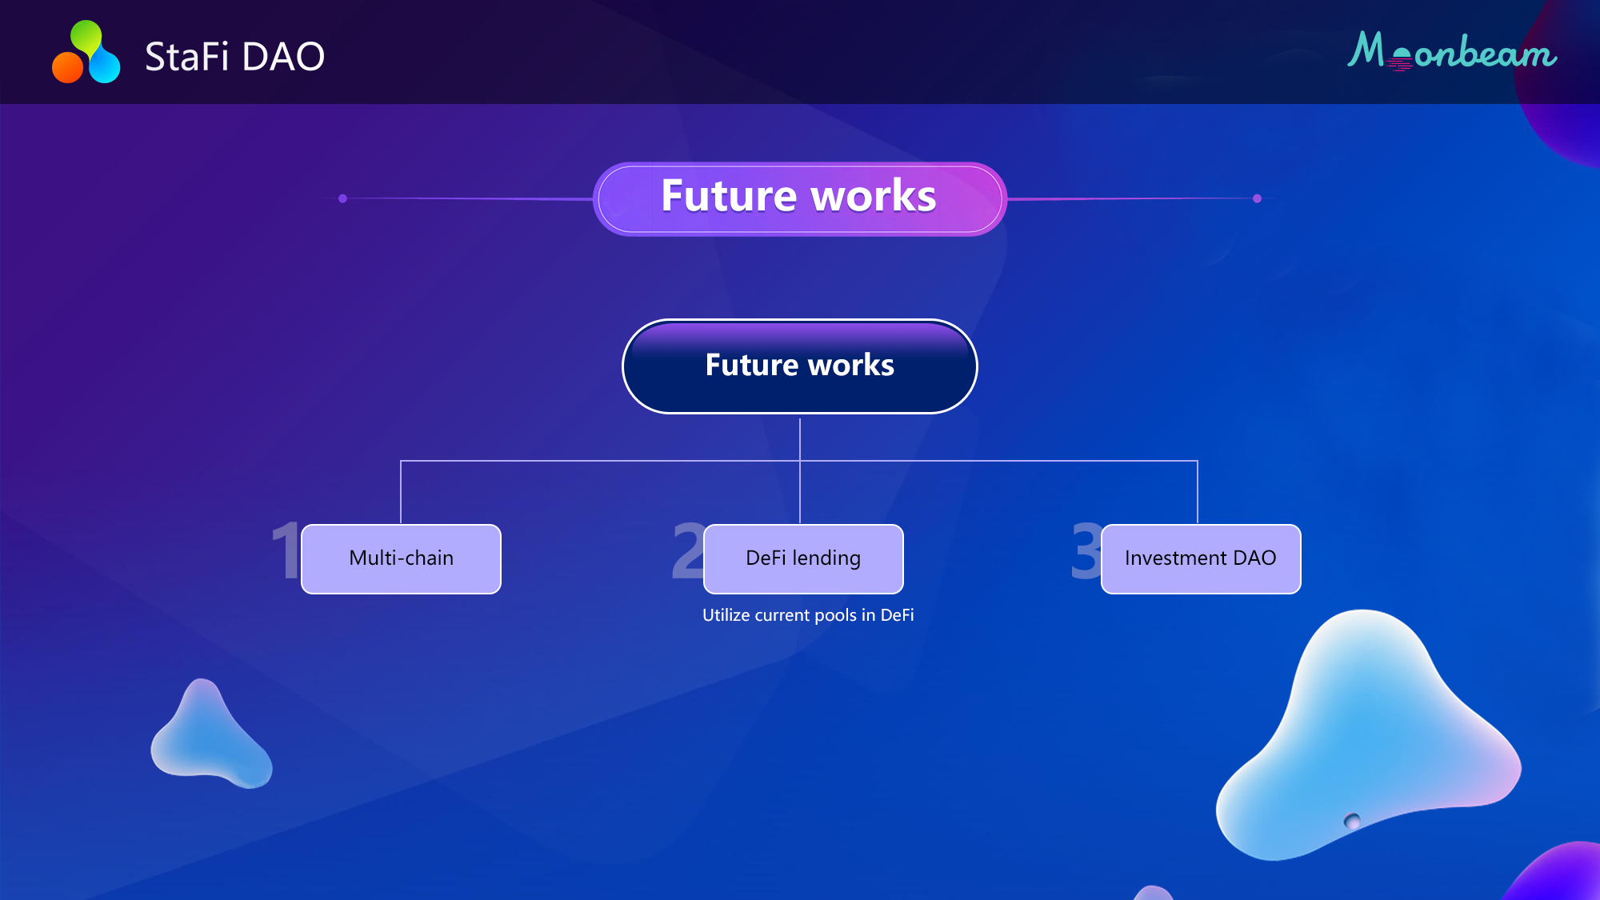

Slide 18
Thank you!

